Slide 1
Object-Based Databases

Slide 2
Limitations of traditional Database system
Databases are applied to wider range of applications like
  CAD and
  GIS
Limitations to relational Databases complex data types not allowed
Difficult to access database from programs written in Java, C++ etc.

Slide 3
Object-Based Databases
Complex Data Types and Object Orientation
Structured Data Types and Inheritance in SQL
Table Inheritance
Array and Multiset Types in SQL
Object Identity and Reference Types in SQL
Implementing O-R Features
Persistent Programming Languages
Comparison of Object-Oriented and Object-Relational Databases

Slide 4
Object-Relational Data Models
Extend the relational data model by including object orientation and constructs to deal with added data types.
Allow attributes of tuples to have complex types, including non-atomic values such as nested relations.
Preserve relational foundations, in particular the declarative access to data, while extending modeling power.
Upward compatibility with existing relational languages.

Slide 5
Object Relational DBMS(ORDBMS)
RDBMS Concept
OOPS Concept
Secondary storage Management
Schema Management
Concurrency Control
Transaction management
Recovery
Query Processing
Access authorization and control, safety, security
Complete Objects
Object identities
User-defined types (ADTs)
Encapsulation
Type/class hierarchy with inheritance
Overloading, overriding, polymorphism

Slide 6
Reasons for having ORDBMSs over conventional RDBMs
Storage requirements of newer applications
Handling of data stored for newer applications
Ability to define user define data types
Reusability nature of objects
Database extensibility

Slide 7
Complex Data Types
Motivation:
  Permit non-atomic domains (atomic ≡ indivisible)
  Example of non-atomic domain: set of integers, strings,or set of tuples
  Eg. Address(street_address, city, state ,postal_code)
  Allows more natural modeling for applications with complex data
Natural definition:
  allow relations whenever we allow atomic (scalar) values — relations within relations
  Violates first normal form.

Slide 8
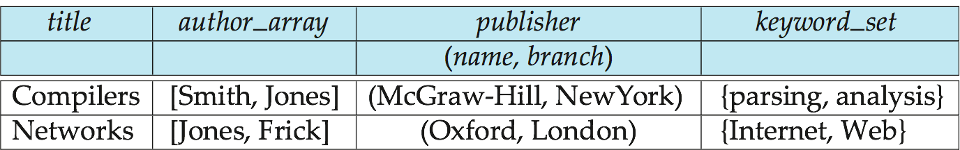
Example of a Nested Relation
Example: library information system
Each book has
  title,
  a list (array) of authors,
  Publisher, with subfields name and branch, and
  a set of keywords
Non-1NF relation books

Slide 9
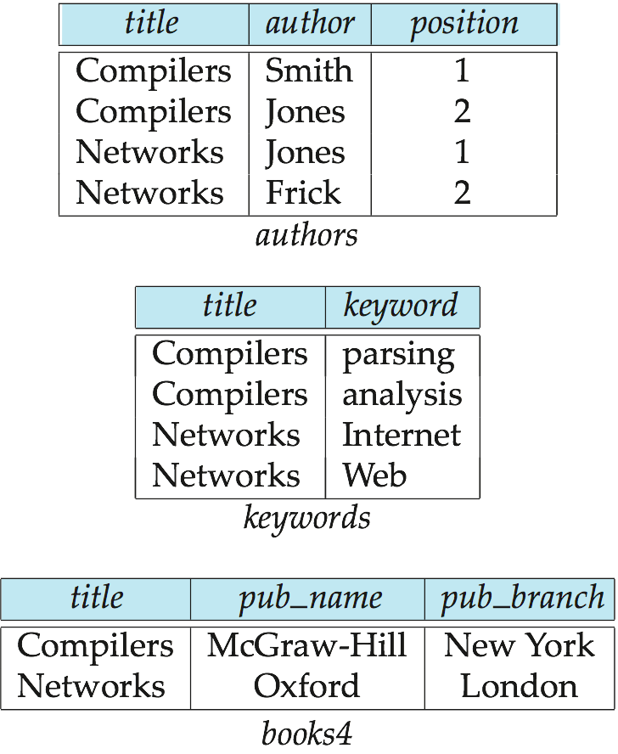
4NF Decomposition of Nested Relation
Suppose for simplicity that title uniquely identifies a book
  In real world ISBN is a unique identifier
Decompose books into 4NF using the schemas:
  (title, author, position )
  (title, keyword )
  (title, pub-name, pub-branch )
4NF design requires users to include joins in their queries.

Slide 10
Complex Types and SQL
Extensions introduced in SQL:1999 to support complex types:
  Collection and large object types
    Nested relations are an example of collection types
  Structured types
    Nested record structures like composite attributes
  Inheritance
  Object orientation
    Including object identifiers and references
Not fully implemented in any database system currently
  But some features are present in each of the major commercial database systems
    Read the manual of your database system to see what it supports

Slide 11
Structured Types and Inheritance in SQL
Structured types (a.k.a. user-defined types) can be declared and used in SQL
create type Name as
(firstname varchar(20),
lastname varchar(20))
final
create type Address as
(street varchar(20),
city varchar(20),
zipcode varchar(20))
not final
  Note: final and not final indicate whether subtypes can be created
Structured types can be used to create tables with composite attributes
create table person (
name Name,
address Address,
dateOfBirth date)
Dot notation used to reference components: name.firstname
select name.firstname, address.city from person

Slide 12
Structured Types (cont.)
User-defined row types for table creation
  create type PersonType as (
  name Name,
  address Address,
  dateOfBirth date)
  not final
Can then create a table whose rows are a user-defined type
create table person of PersonType
Alternative using unnamed row types.
create table person_r(
name row(firstname varchar(20),
lastname varchar(20)),
address row(street varchar(20),
city varchar(20),
zipcode varchar(20)),
dateOfBirth date)

Slide 13
Methods
Can add a method declaration with a structured type.
method ageOnDate (onDate date)
returns interval year
Method body is given separately.
  create instance method ageOnDate (onDate date)
  returns interval year
  for PersonType
  begin
  return onDate - self.dateOfBirth;
  end
We can now find the age of each customer:
  select name.lastname, ageOnDate (current_date)
  from person
  create type PersonType as (
  name Name,
  address Address,
  dateOfBirth date)
  not final
method ageOnDate
(onDate date)
returns interval year

Slide 14
Array and Multiset Types in SQL
Example of array and multiset declaration:
create type Publisher as
(name varchar(20),
branch varchar(20));
create type Book as
(title varchar(20),
author_array varchar(20) array [10],
pub_date date,
publisher Publisher,
keyword-set varchar(20) multiset);
create table books of Book;

Slide 15
Creation of Collection Values
Array construction
array [‘Silberschatz’,`Korth’,`Sudarshan’]
Multisets
  multiset [‘computer’, ‘database’, ‘SQL’]
To create a tuple of the type defined by the books relation: (‘Compilers’, array[`Smith’,`Jones’],
new Publisher (`McGraw-Hill’,`New York’), multiset [`parsing’,`analysis’ ])
To insert the preceding tuple into the relation books
insert into books
values
(‘Compilers’, array[`Smith’,`Jones’],
new Publisher (`McGraw-Hill’,`New York’),
multiset [`parsing’,`analysis’ ]);

Slide 16
Constructor Functions
Constructor functions are used to create values of structured types
E.g.
create function Name(firstname varchar(20), lastname varchar(20))
returns Name
begin
set self.firstname = firstname;
set self.lastname = lastname;
end
To create a value of type Name, we use
new Name(‘John’, ‘Smith’)
Normally used in insert statements
insert into Person values
(new Name(‘John’, ‘Smith),
new Address(’20 Main St’, ‘New York’, ‘11001’),
date ‘1960-8-22’);

Slide 17
Type Inheritance
Suppose that we have the following type definition for people:
create type Person
(name varchar(20),
address varchar(20))
Using inheritance to define the student and teacher types
create type Student
under Person
(degree varchar(20),
department varchar(20))
create type Teacher
under Person
(salary integer,
department varchar(20))
Subtypes can redefine methods by using overriding method in place of method in the method declaration

Slide 18
Multiple Type Inheritance
SQL:1999 and SQL:2003 do not support multiple inheritance
If our type system supports multiple inheritance, we can define a type for teaching assistant as follows:
create type Teaching Assistant
under Student, Teacher
To avoid a conflict between the two occurrences of department we can rename them
create type Teaching Assistant
under
Student with (department as student_dept ),
Teacher with (department as teacher_dept )
Each value must have a most-specific type
Immediate supertype of new subtype
Suppose entity has type person and student then its most specific type is student and not person
Entity related to type like Teaching Assistant has both teacher and students as most specific types.

Slide 19
Table Inheritance
Tables created from subtypes can further be specified as subtables
E.g. create table people of Person;
create table students of Student under people;
create table teachers of Teacher under people;
Tuples added to a subtable are automatically visible to queries on the supertable
  E.g. query on people also sees students and teachers.
  Similarly updates/deletes on people also result in updates/deletes on subtables
  To override this behaviour, use “only people” in query
Conceptually, multiple inheritance is possible with tables
  e.g. teaching_assistants under students and teachers
  But is not supported in SQL currently
    So we cannot create a person (tuple in people) who is both a student and a teacher

Slide 20
Consistency Requirements for Subtables
Consistency requirements on subtables and supertables.
  Each tuple of the supertable (e.g. people) can correspond to at most one tuple in each of the subtables (e.g. students and teachers)
  Additional constraint in SQL:1999:
  All tuples corresponding to each other (that is, with the same values for inherited attributes) must be derived from one tuple (inserted into one table).
    That is, each entity must have a most specific type
    We cannot have a tuple in people corresponding to a tuple each in students and teachers

Slide 21
Querying Collection-Valued Attributes
To find all books that have the word “database” as a keyword,
select title
from books
where ‘database’ in (unnest(keyword-set ))
We can access individual elements of an array by using indices
  E.g.: If we know that a particular book has three authors, we could write:
select author_array[1], author_array[2], author_array[3]
from books
where title = `Database System Concepts’
To get a relation containing pairs of the form “title, author_name” for each book and each author of the book
select B.title, A.author
from books as B, unnest (B.author_array) as A (author )
To retain ordering information we add a with ordinality clause
select B.title, A.author, A.position
from books as B, unnest (B.author_array) with ordinality as
A (author, position )

Slide 22
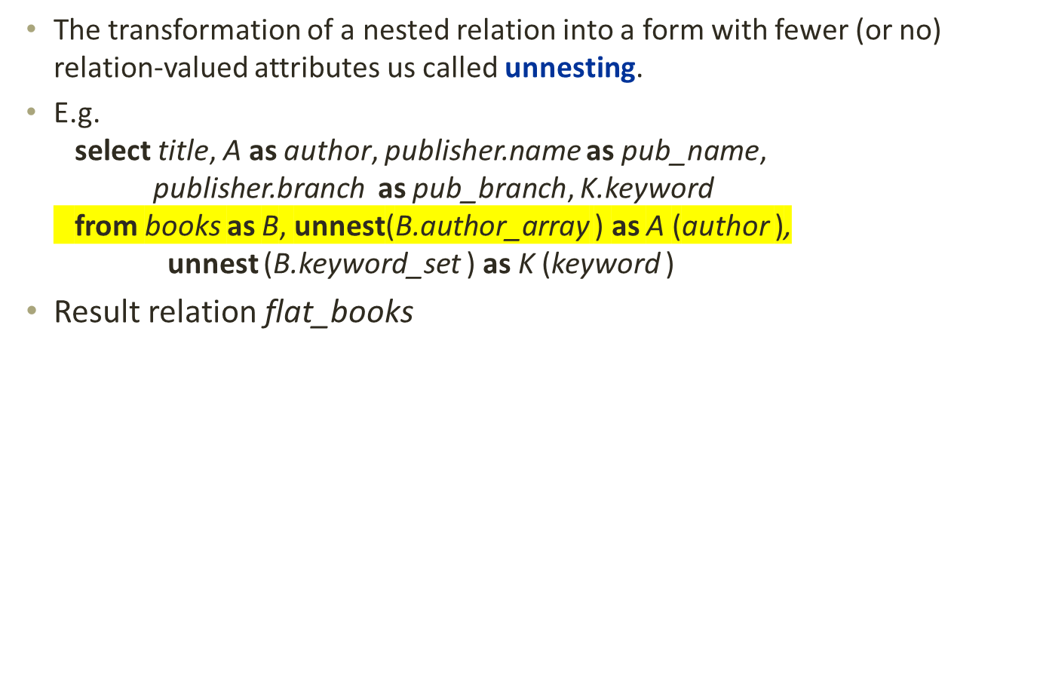
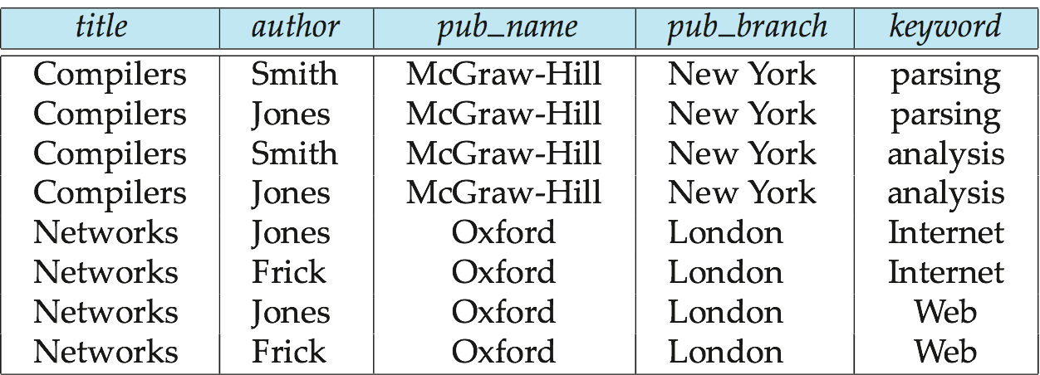
Unnesting

Slide 23
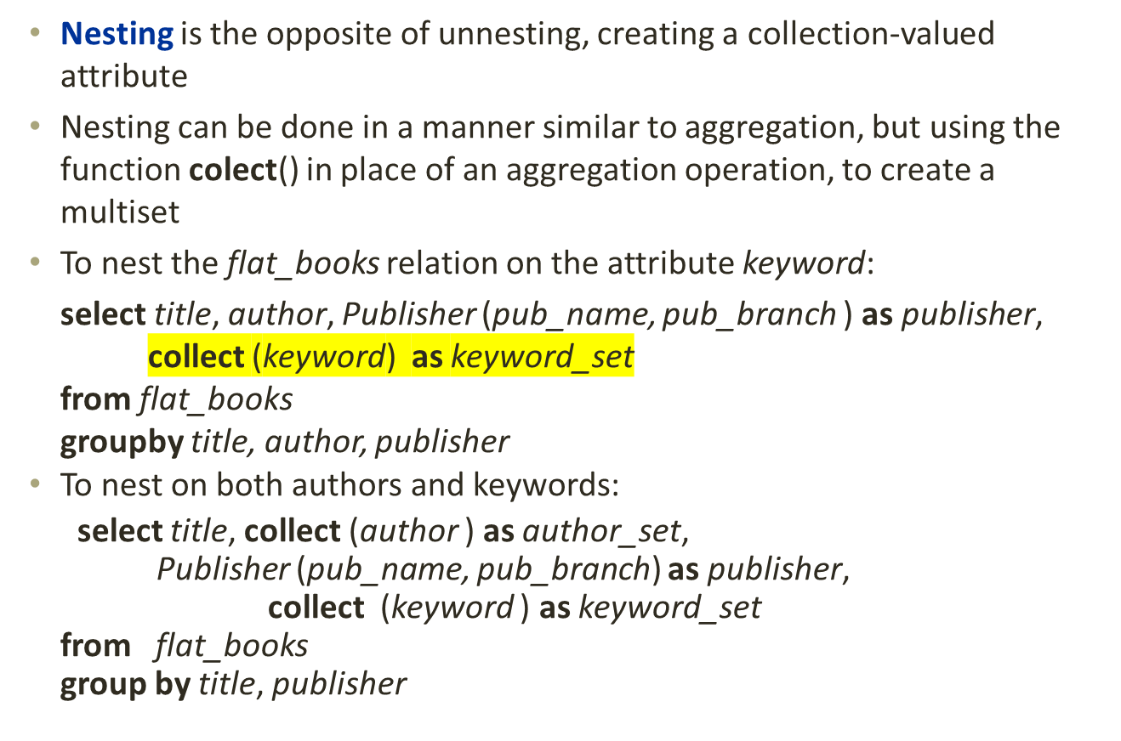
Nesting

Slide 24
Nesting (Cont.)
Another approach to creating nested relations is to use subqueries in the select clause, starting from the 4NF relation books4
select title,
array (select author
from authors as A
where A.title = B.title order by A.position) as author_array,
Publisher (pub-name, pub-branch) as publisher,
multiset (select keyword
from keywords as K
where K.title = B.title) as keyword_set
from books4 as B

Slide 25
Object-Identity and Reference Types
Define a type Department with a field name and a field head which is a reference to the type Person, with table people as scope:
create type Department (
name varchar (20),
head ref (Person) scope people)
We can then create a table departments as follows
create table departments of Department
We can omit the declaration scope people from the type declaration and instead make an addition to the create table statement:
create table departments of Department
(head with options scope people)
Referenced table must have an attribute that stores the identifier, called the self-referential attribute
create table people of Person
ref is person_id system generated;

Slide 26
Initializing Reference-Typed Values
To create a tuple with a reference value, we can first create the tuple with a null reference and then set the reference separately:
insert into departments
values (`CS’, null)
update departments
set head = (select p.person_id
from people as p
where name = `John’)
where name = `CS’

Slide 27
User Generated Identifiers
The type of the object-identifier must be specified as part of the type definition of the referenced table, and
The table definition must specify that the reference is user generated
create type Person
(name varchar(20)
address varchar(20))
ref using varchar(20)
create table people of Person
ref is person_id user generated
When creating a tuple, we must provide a unique value for the identifier:
  insert into people (person_id, name, address ) values
  (‘01284567’, ‘John’, `23 Coyote Run’)
We can then use the identifier value when inserting a tuple into departments
  Avoids need for a separate query to retrieve the identifier:
insert into departments
values(`CS’, `02184567’)

Slide 28
User Generated Identifiers (Cont.)
Can use an existing primary key value as the identifier:
create type Person
(name varchar (20) primary key,
address varchar(20))
ref from (name)
create table people of Person
ref is person_id derived
When inserting a tuple for departments, we can then use
insert into departments
values(`CS’,`John’)

Slide 29
Path Expressions
Find the names and addresses of the heads of all departments:
select head –>name, head –>address
from departments
An expression such as “head–>name” is called a path expression
Path expressions help avoid explicit joins
  If department head were not a reference, a join of departments with people would be required to get at the address
  Makes expressing the query much easier for the user

Slide 30
Implementing O-R Features
Similar to how E-R features are mapped onto relation schemas
Subtable implementation
  Each table stores primary key and those attributes defined in that table
  or,
  Each table stores both locally defined and inherited attributes

Slide 31
Persistent Programming Languages
Languages extended with constructs to handle persistent data
DB handling languages are persistent but host languages are not
Types are different so conversion is required
Programmer can manipulate persistent data directly
  no need to fetch it into memory and store it back to disk (unlike embedded SQL)
Persistent objects:
  Persistence by class - explicit declaration of persistence
  Persistence by creation - special syntax to create persistent objects
  Persistence by marking - make objects persistent after creation
  Persistence by reachability - object is persistent if it is declared explicitly to be so or is reachable from a persistent object

Slide 32
Object Identity and Pointers
Degrees of permanence of object identity
  Intraprocedure: only during execution of a single procedure
  Eg. Local variables
  Intraprogram: only during execution of a single program or query
  Eg. Global variables
  Interprogram: across program executions, but not if data-storage format on disk changes
  Persistent: interprogram, plus persistent across data reorganizations
Persistent versions of C++ and Java have been implemented
  C++
    ODMG(object data management group standard) C++
  Java
    Java Database Objects (JDO)

Slide 33
Persistent C++ Systems
Extensions of C++ language to support persistent storage of objects
Several proposals, ODMG standard proposed, but not much action of late
  persistent pointers: e.g. d_Ref<T>
  creation of persistent objects: e.g. new (db) T()
  Class extents: access to all persistent objects of a particular class
  Relationships: Represented by pointers stored in related objects
    Issue: consistency of pointers
    Solution: extension to type system to automatically maintain back-references
  Iterator interface
  Transactions
  Updates: mark_modified() function to tell system that a persistent object that was fetched into memory has been updated
  Query language

Slide 34
Persistent Java Systems
Standard for adding persistence to Java : Java Database Objects (JDO)
  Persistence by reachability
  Byte code enhancement
    Classes separately declared as persistent
    Byte code modifier program modifies class byte code to support persistence
      E.g. Fetch object on demand
      Mark modified objects to be written back to database
  Database mapping
    Allows objects to be stored in a relational database
  Single reference type
    no difference between in-memory pointer and persistent pointer

Slide 35
Object-Relational Mapping
Object-Relational Mapping (ORM) systems built on top of traditional relational databases
Implementer provides a mapping from objects to relations
  Objects are purely transient, no permanent object identity
Objects can be retrived from database
  System uses mapping to fetch relevant data from relations and construct objects
  Updated objects are stored back in database by generating corresponding update/insert/delete statements
The Hibernate ORM system is widely used
  described in Section 9.4.2
  Provides API to start/end transactions, fetch objects, etc
  Provides query language operating direcly on object model
    queries translated to SQL
Limitations: overheads, especially for bulk updates

Slide 36
Comparison of O-O and O-R Databases
Relational systems
  simple data types, powerful query languages, high protection.
Persistent-programming-language-based OODBs
  complex data types, integration with programming language, high performance.
Object-relational systems
  complex data types, powerful query languages, high protection.
Object-relational mapping systems
  complex data types integrated with programming language, but built as a layer on top of a relational database system
Note: Many real systems blur these boundaries
  E.g. persistent programming language built as a wrapper on a relational database offers first two benefits, but may have poor performance.

Slide 37
End of Chapter 22

Slide 38
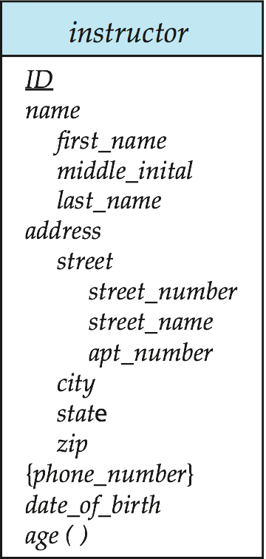
Figure 22.05

Slide 39

Figure 22.07

